Slide 1





JavaScript Tools
Tools for Writing / Editing / Debugging JavaScript Code
Svetlin Nakov
Technical Trainer
www.nakov.com
Software University
http://softuni.bg

Slide 2

Table of Contents
JavaScript Development Tools
Visual Studio 2013
Sublime Text with plugins
WebStorm
Debugging tools
Google Chrome / Opera Developer Tools
Firefox Firebug
Internet Explorer F12
Utilities

Slide 3

JavaScript Tools
Know your Tools!

Slide 4
JavaScript Tools
JavaScript is an interpreted language
It is run and executed by the browser
The means to acquire the JavaScript code are trivial
No matter how or where it is coded
A simple Notepad will do the trick
Yet, there are many tools that easify JavaScript coding
Like editors, debuggers, etc…

Slide 5


JavaScript Development Tools
Coding JavaScript made easy!

Slide 6
JavaScript Development Tools
All a developer needs for coding JavaScript is a text editor
Notepad/Notepad++ will do the trick
Yet, JavaScript is one of the popular guys now
Many, many tools for coding JavaScript
Sublime Text
Visual Studio 2012/2013
Adobe Brackets, Cloud9, Telerik AppBuilder, WebStorm
JavaScript Development Tools for Eclipse

Slide 7

Visual Studio

Slide 8
Visual Studio
Visual Studio is the main dev tool for creating .NET apps
ASP.NET, WPF, Silverlight, SharePoint, Windows 8, etc…
Until Windows 8 and version 2012, Visual Studio was not a pleasant tool for coding JavaScript
Microsoft put JavaScript into the core of Windows 8, so their development tool needed to be done right
Use Visual Studio 2012 or Visual Studio 2013

Slide 9
Visual Studio 2012/2013
VS 2012/2013 are pretty much ready-to-use for JavaScript coding
They have pretty good intelli-sense, code highlighting, etc…
There are paid and free versions (Visual Studio 2012/2013 Web Developer)

Slide 10

Node.js Tools for Visual Studio
Visual Studio has Node.js Tools
http://nodejstools.codeplex.com
Runs Node.js into Visual Studio
Powerful, well integrated debugger
Has no DOM, runs out of the browser

Slide 11
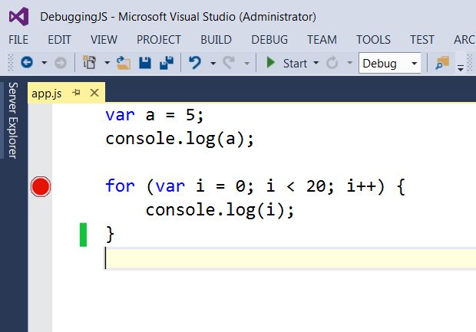
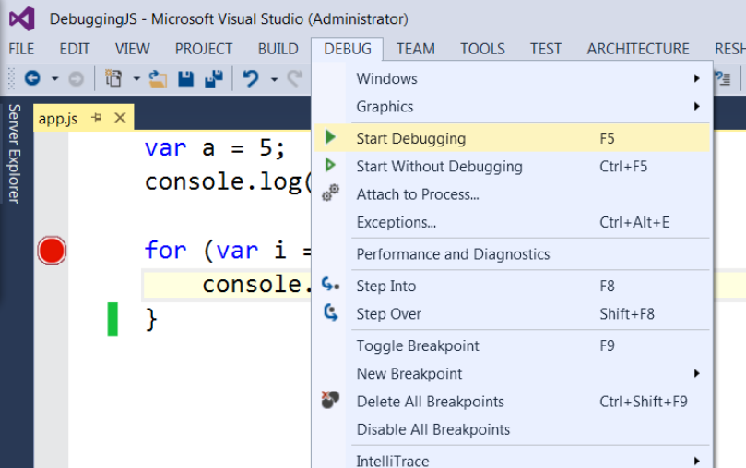
Debugging node.js in Visual Studio
Just like C# debugger
Add breakpoint and start debugging with F5

Slide 12
Visual Studio 2012/2013
Live Demo

Slide 13
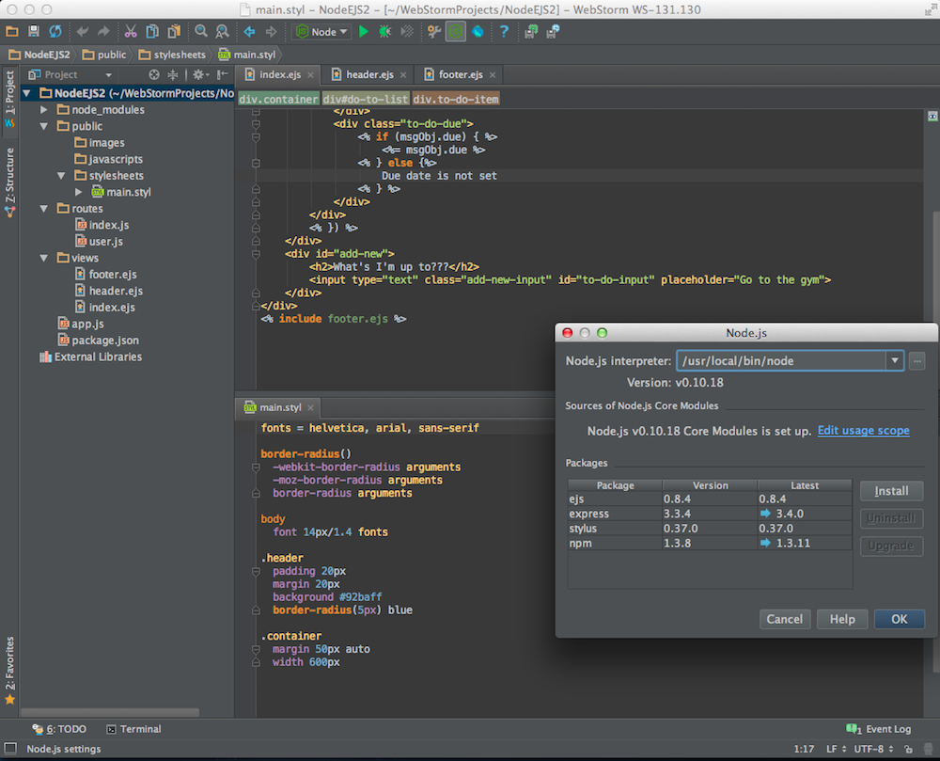
WebStorm
The Smartest JavaScript IDE

Slide 14
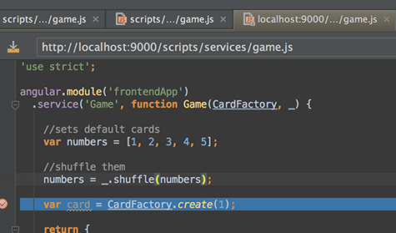
WebStorm
JavaScript IDE suitable for both client-side JS and server-side (Node.js) development
Build JavaScript code
Debug JavaScript code
Code intellisense for:
SASS/LESS/Stylus CSS preprocessors
CoffeeScript/TypeScript JavaScript preprocessors
Emmet coding
Paid product (free 1 year license for SoftUni student)

Slide 15
Debugging JavaScript
Using All the Tools

Slide 16
Debugging JavaScript
Sadly, no intelligent way of debugging client-side JavaScript
The only way to debug JavaScript is through the browser
Fortunately all browsers have their own debugging tool/plugin that makes it easier
Firefox has Firebug
Chrome and Opera have Web Developer Tools
Internet Explorer has [F12]

Slide 17
Debugging JavaScript
Live Demo

Slide 18
JavaScript Utilities
Tools for JS Developers

Slide 19
JavaScript Utilities
JavaScript Code Quality Tools
http://www.jshint.com
http://www.jslint.com
HTML, CSS and JavaScript playgrounds
http://jsbin.com
http://liveweave.com
JavaScript performance tester
http://jsperf.com

Slide 20
JavaScript Utilities
Live Demo

Slide 21


Summary
JS Developer Tools
WebStorm
Visual Studio
JS Debuggers
The [F12] Tools
JS Utilities
JSHint, JSLint, JSBin, …
JS Basics

Slide 22







JavaScript Tools
https://softuni.bg/courses/javascript-basics

Slide 23
License
This course (slides, examples, demos, videos, homework, etc.) is licensed under the "Creative Commons Attribution-NonCommercial-ShareAlike 4.0 International" license
Attribution: this work may contain portions from
“JavaScript Basics" course by Telerik Academy under CC-BY-NC-SA license

Slide 24





Free Trainings @ Software University
Software University Foundation – softuni.org
Software University – High-Quality Education, Profession and Job for Software Developers
softuni.bg
Software University @ Facebook
facebook.com/SoftwareUniversity
Software University @ YouTube
youtube.com/SoftwareUniversity
Software University Forums – forum.softuni.bg

